Slide 1
Flight management system
TEAM MEMBERS:
Anushka Soni
Shivam Amravanshi
Anirudh Bhardwaj
Rashmi Tiwari

Slide 2
ABSTRACT
The Flight Management System is a SPRING BOOT APPLICATION with RESTFUL WEBSERVICES booking solution for flight tickets.
It consolidates data provided by different airline carriers and hence provides the user details and and rates in real-time.
Travellers may want to make changes in their bookings. The application allows them to book, cancel, view their bookings with ease.
Other than this, it eases the management of bookings too.

Slide 3
Technology & Architecture
It is a Spring Boot Application with RESTFULL WEB SERVICES with following specifications:
Architecture: MVC (Model View Controller)
Technology: Java
Build Tool: Maven (For providing easy build options and dependencies)
Validations: Spring Validations (using Spring’s Validator interface using @Valid annotations)
UI:ANGULAR 6+
Database: HSQLDB
IDE: ECLIPSE
Server: Apache Tomcat Server

Slide 4
ABOUT SPRING BOOT
Spring Boot is a Framework from “The Spring Team” to ease the bootstrapping and development of new Spring Applications.
It provides defaults for code and annotation configuration to quick start new Spring projects within no time.
It follows “Opinionated Defaults Configuration” Approach to avoid lot of boilerplate code and configuration to improve Development, Unit Test and Integration Test Process.

Slide 5
Coding & Best Practices
SDLC Model used: Agile (Scrum Framework)
Regular scrum meeting and proper user stories distribution.
Proper Documentation.
Proper Client and Server side validations for each user stories.
Exception class to catch any kind of exception occurring in the application the run-time
Service layer for better scalability and loosely-coupled application.

Slide 6
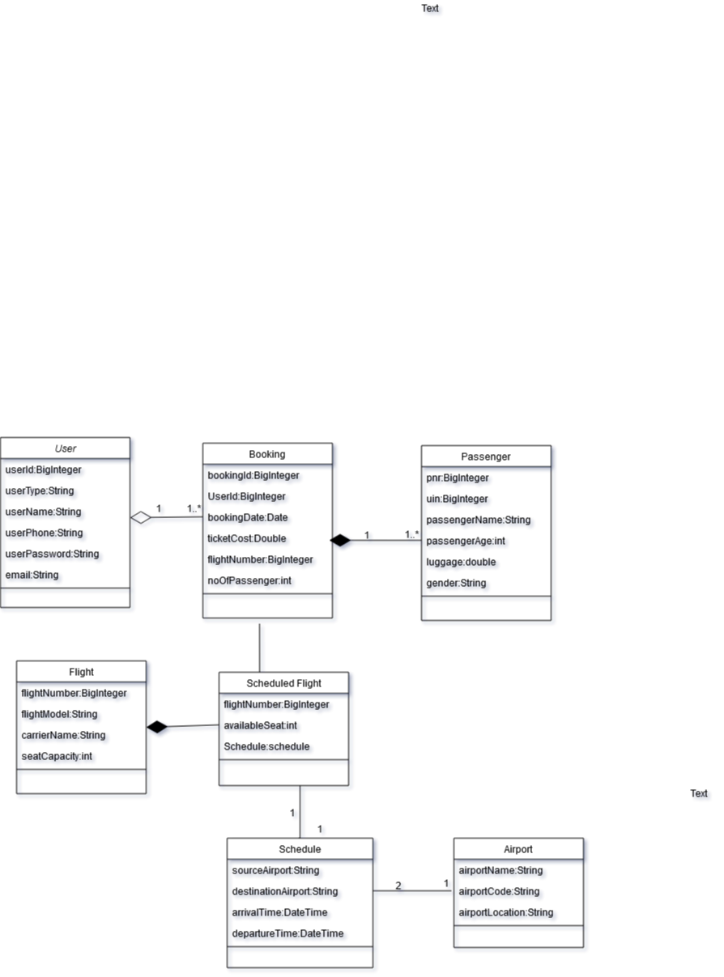

Slide 7
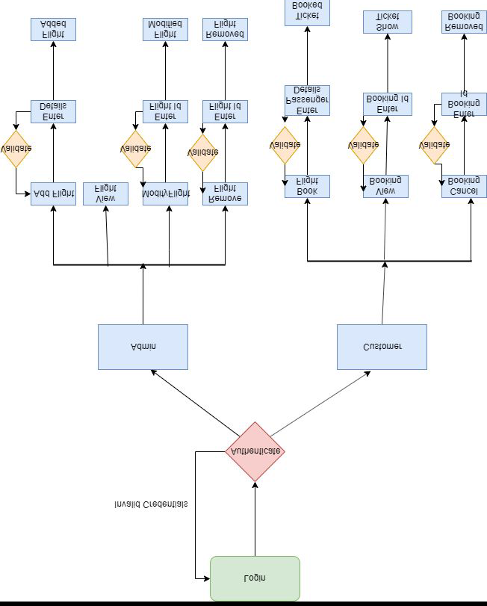

Slide 8
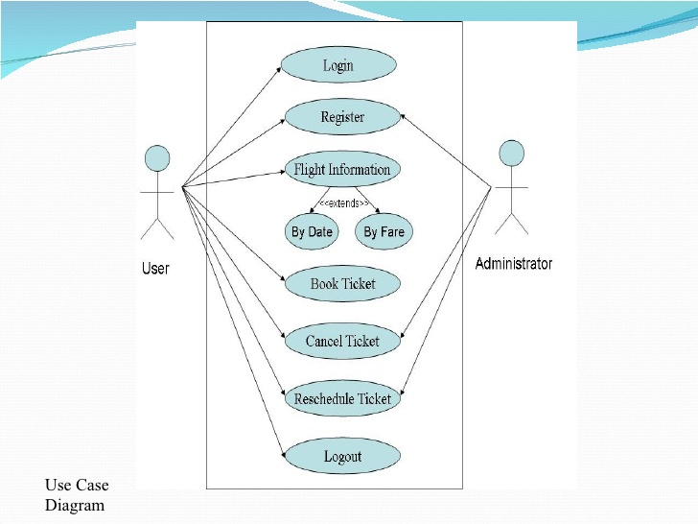

Slide 9
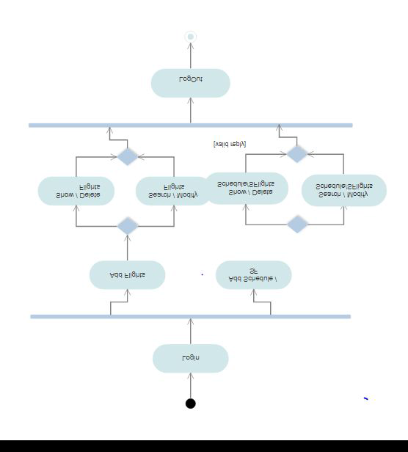

Slide 10
Assumptions:
However, we have made a few assumptions with respect to the application, which are:
1. Administrator and customer are both Users. They are differentiated by a variable ‘userType’ in the User class.
2. Every passenger needs to enter a Unique Identification Number while booking is being made. For simplicity, we assume it to be a 12-digit Aadhaar Number.
3. All flights are direct flights.
4. No flight gets cancelled.
5. Number of airports is fixed and stored in database.
6. All the flights are considered to be domestic.

Slide 11
THANK YOU

